Slide 1
Web Cryptography Workshop
Charles Engelke and Laurie White
March 8, 2016
fluent@engelke.com fluent@lauriewhite.org

Slide 2
Workshop Materials
Clone or download GitHub repository
https://github.com/engelke/fluent2016
Or get Zip or unzipped folder from USB key
W3C Web Cryptography API specification
https://www.w3.org/TR/WebCryptoAPI/
WebCrypto API “Cheat Sheet”
In repo, paper versions being passed out

Slide 3
Today’s Workshop
What the Web Cryptography API is, and why it’s important
Core concepts needed
A little crypto, a bit of JavaScript
Hands on with the API
Clone or download the GitHub repo to your machine
Each lab has its own subdirectory

Slide 4
The Web Cryptography API
www.w3.org/TR/WebCryptoAPI/
A W3C Candidate Recommendation
Next step is Proposed Recommendation
Waiting for more complete browser implementations
But enough of it is widely supported to use now
Provides access to native crypto libraries from the browser
Allowing end-to-end encryption and authentication

Slide 5
Why Not Code Crypto in JavaScript?
Cryptographic algorithms tend to be slow
JavaScript keeps getting faster and faster, but it’s still much slower than native code
Implementing secure cryptography is hard
It’s not enough that the code produce the right output
All kinds of security attacks are possible
The native crypto libraries used by the API aren’t just native, they’re also battle-tested

Slide 6











API Browser Availability
Prefixed, Incomplete
Prefixed, Old API
OS:

Slide 7
Do We Need Crypto in the Browser?
Isn’t TLS enough?
And isn’t the browser completely insecure, anyway?
No, not for some use cases
TLS does not provide end-to-end security
Security of code in the browser not significantly lower than on auto-updating native platforms

Slide 8


Protect Secrets, Authenticate Others

Slide 9
HTTP is Not Secure
Can intercept and alter
Can intercept and alter

Slide 10
Add TLS (Lock)

Slide 11
HTTPS is Secure
Can’t Eavesdrop
Can’t Eavesdrop

Slide 12
TLS Protects Connections, Not Messages
Can’t Eavesdrop
Can’t Eavesdrop
MITM Can Listen and Alter

Slide 13
End-to-End Cryptography
Senders sign and encrypt messages inside browser
Before it ever leaves their PCs
Recipients verify and decrypt inside browser
On a PC they control
Intermediaries can interfere with messages
But can’t alter them without detection
And can’t read them

Slide 14
Use the Web Cryptography API
Protected with in-browser cryptography
MITM Can’t Eavesdrop or Alter

Slide 15
So Replace TLS with Web Crypto?
No. TLS ensures that the right code is delivered to the user’s browser
Without it, attacker can deliver pages with crypto backdoors, allowing bypass of end-to-end protection
Chicken and egg problem
You can’t trust any connection not protected by an already trusted connection
Root certificates in the browser are ultimate check

Slide 16
Web Cryptography API Overview

Slide 17
API Lives in the Browser’s DOM
Not part of JavaScript, but usable by JavaScript
So, not in Node.js (though modules exist)
window.crypto object
window.crypto.getRandomValues
Cryptographically strong random numbers
window.crypto.subtle
Most of the API consists of methods of this object

Slide 18
Try It Yourself
Go to a web page, open the console
Control-Shift-I for Chrome, Opera, or Firefox on Windows and Linux
F12 for Edge
Try engelke.com
Redirects to secure page
API only functional for secure origins

Slide 19
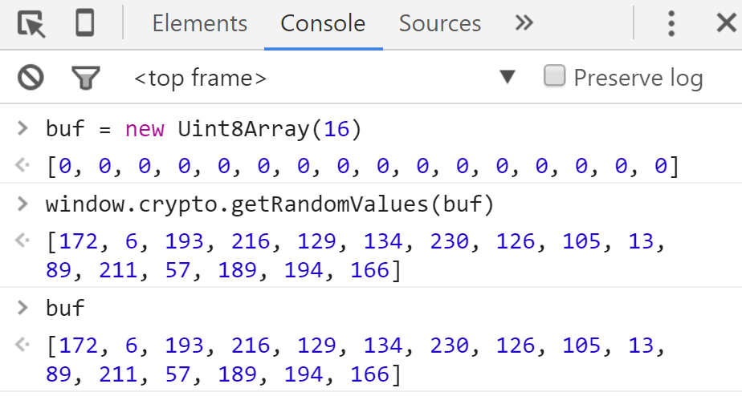
Hands-on Via the Console

Slide 20
buf = new Uint8Array(16)
Creates a new buffer and points buf at it
Uint8Array is one kind of Typed Array
Not like a normal JavaScript array
More like a C array
16 contiguous 8-bit memory locations
We’ll usually call it a byte array in this workshop

Slide 21
window.crypto.getRandomValues(buf)
getRandomValues takes any ArrayBuffer (abstraction of Typed Arrays)
Fills it with cryptographically strong random values
And returns the object it is given, now filled

Slide 22
How is this Crypto?
Many cryptographic operations require randomness in order to be secure
Common pseudorandom generators are often not “random” (unpredictable) enough; this is
Though this is synchronous, so it can’t wait for more system entropy, which can be a weakness

Slide 23
SubtleCrypto – Most of the API
Lives in window.crypto.subtle
Called subtle because “many of these algorithms have subtle usage requirements” in order to be secure
Puts users on notice to be careful
All methods are asynchronous
May be slow, or may need to wait for more entropy
Return Promises instead of using callbacks

Slide 24
SubtleCrypto Methods
generateKey
importKey
exportKey
deriveKey
deriveBits
digest
encrypt
decrypt
sign
verify
wrapKey
unwrapKey

Slide 25
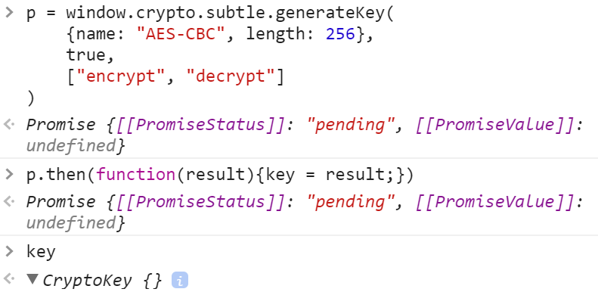
Hands-on

Slide 26
p = window.crypto.subtle.generateKey( {name: "AES-CBC", length: 256}, true, ["encrypt", "decrypt"] )
Parameters are AlgorithmIdentifier, Extractable, and Usages
Need to reference the spec to determine appropriate values
Returns a Promise, not the requested key

Slide 27
p.then(function(result) { key = result; })
Promise’s then method takes a function
Invokes that function with the operation’s result, if and when the operation concludes successfully
In this case, we copy the result to a relatively global (key) variable for inspection
Note that the operation’s result is a CryptoKey object

Slide 28
Don’t Do This in a Real Program!
The example never invoked the Promise’s catch method
Takes a function parameter that is called if and when an exception occurs
Never assume you don’t need to check this!
p.catch(function(err){ // handle the error })

Slide 29
Some API Basics

Slide 30
Important Object Types
ArrayBuffer
Abstract block of data. Used to return data from API.
Uint8Array
Block of data, addressable by index. Can give this type of data to API.
CryptoKey
Opaque object created via the API
Actual value of the key not accessible from JavaScript
Key value can be exported, if the key creator allows it

Slide 31
ArrayBuffer Tips
Can’t be manipulated directly
Only byteLength property is readable
Cast to Uint8Array to use
Example: buf is ArrayBuffer returned from API
byteArray = new Uint8Array(buf); alert("First byte is " + byteArray[0]);
You can provide a Uint8Array whenever API wants an ArrayBuffer

Slide 32
Promise
Object representing a deferred result
The then method handles the result
then(onSuccess, onRejection)
Parameters are functions invoked when appropriate
then(f) shorthand for then(f, )
catch(f) shorthand for then( , f)

Slide 33
then and catch Return Promises
So they can be chained
first().then().then().then().then().then().catch()
Exceptions will “fall through” until there’s a catch
For example, consider:
p = fn.then(function(param) {return result;})
If result is itself a Promise, p does whatever result does
Otherwise, p is a Promise that yields result on successful completion.

Slide 34
Hands-on Labs

Slide 35
Lab Exercises
Symmetric encryption (with random key)
Also a variant that works in Internet Explorer 11
Password-based key derivation
Digital signatures
Public key cryptography
X.509 self-signed certificate

Slide 36
Structure of Each Lab
Skeleton is provided to you in Labs/n
labn.html, labn.css for page structure
util.js has general-purpose helper functions
wiring.js places listeners on buttons, other project-specific helpers
labn.js is for your solution
Working solutions available in Solutions/n

Slide 37
Lab 1 – Symmetric Encryption

Slide 38
Basic Concepts
Symmetric encryption uses one key (also known as the secret key) to encrypt and decrypt data
The original data is called plaintext
Encrypted data is called ciphertext
The secret key must be shared with all parties that are communicating

Slide 39
Symmetric Encryption
secret key
plaintext
symmetric algorithm
ciphertext

Slide 40
Symmetric Algorithms
Stream and Block ciphers
Stream ciphers include One-time pad, RC4, Salsa20
Block ciphers include DES, IDEA, AES, Blowfish
Which to use?
You don’t have to choose, because there is no choice
The API supports only AES

Slide 41
Block Cipher Issues
They only encrypt fixed-size blocks of data
16 byte blocks for AES
Naïve users have been known to use a single key to encrypt every block of data
But repeated plaintext leads to repeated ciphertext
Cipher modes tell how to pad incomplete blocks and encrypt each block in a unique way

Slide 42


Why Cipher Mode Matters
AES Encrypt
Original image courtesy lewing@isc.tamu.edu and The GIMP

Slide 43
AES Modes Supported by the API
AES-CBC is widely used and supported
It’s a good choice, with one major weakness: ciphertext can be changed undetectably
We will use it in today’s labs
AES-GCM is considered a better choice
But not universally supported yet
AES-CTR and AES-CFB not widely supported in browsers
Likely to be dropped from the API
AES-KW is a specialty mode, only for encrypting keys

Slide 44
Encryption With AES-CBC
Start with plaintext, a key, and an IV
Plaintext is a sequence of bytes
Key is a secret 128, 192, or 256 bits
IV (initialization vector) is 16 random bytes
IV is essential to security
Allows repeated use of the same key without exposing patterns that could break security
End up with ciphertext

Slide 45
Decryption with AES-CBC
Start with ciphertext and key, obviously
But you also need the IV (it’s not secret)
Use the key and IV to decrypt ciphertext
End up with the original plaintext

Slide 46
AES-CBC and the Web Crypto API
Logically, the key is a bit sequence
But the API requires keys to be CryptoKey objects
generateKey can create a good random key
importKey and exportKey convert back and forth to bit sequences
All API data is in be ArrayBuffers
Plaintext, IV, Ciphertext, exported Keys

Slide 47
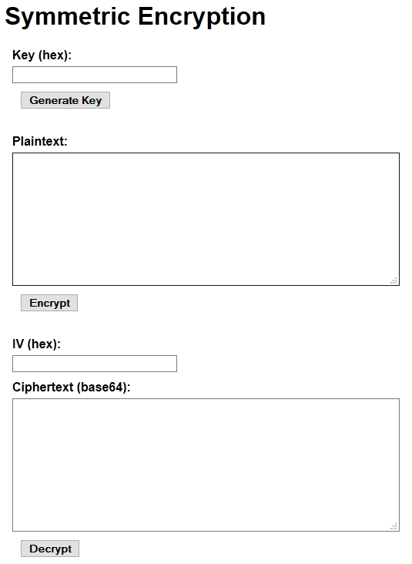
Lab 1 Application
Three operations:
Generate Key
Encrypt
Decrypt
User can copy form data to other browsers
Results are interoperable

Slide 48
Skeleton in Lab/1 in GitHub Repo
Several non-crypto parts already filled out
lab1.html, lab1.css, wiring.js, utils.js
You fill in missing parts of lab1.js
We will do the Generate Key step together first, and review that solution in depth
See Hints in lab1.js skeleton for method specs

Slide 49
Generate Key Specification
On user click
Create a random 256-bit AES-CBC key
Export the key (so it’s visible)
Hex encode the key
Put hex encoding in appropriate form element
Use helper functions
Convert between byte arrays and hex encoded strings

Slide 50
function generateKey() {
// Replace this alert with your solution
window.alert("GenerateKey clicked.");
}

Slide 51
function generateKey() {
// 1 – generateKey
// 2 – exportKey
// 3 – hex encode key
// 4 – put hex encoding in form element
}

Slide 52
function generateKey() {
window.crypto.subtle.generateKey(
{name: "AES-CBC", length: 256},
true,
["encrypt", "decrypt"]
) }

Slide 53
function generateKey() {
window.crypto.subtle.generateKey(
{name: "AES-CBC", length: 256},
true,
["encrypt", "decrypt"]
).then(function(key){
}) }

Slide 54
function generateKey() {
…
).then(function(key){
return window.crypto.subtle.exportKey(
"raw",
key
);
}) }

Slide 55
function generateKey() {
…
).then(function(key){
return window.crypto.subtle.exportKey(
"raw",
key
);
}).then(function(buf){ }) }

Slide 56
function generateKey() {
…
…
}).then(function(buf){
var byteArray = new Uint8Array(buf);
var keyField = document.getElementById("key");
keyField.value = byteArrayToHexString(byteArray);
}) }

Slide 57
function generateKey() {
…
…
}).then(function(buf){
var byteArray = new Uint8Array(buf);
var keyField = document.getElementById("key");
keyField.value = byteArrayToHexString(byteArray);
}).catch(function(err){
}) }

Slide 58
function generateKey() {
…
…
…
}).catch(function(err){
alert("Key generation error: " + err.message);
}); }

Slide 59
Hands-on Exercise to Finish the Lab
Specifications shown next
Will review solution after a break

Slide 60
Encrypt Specification
Read hex encoded key from form element
Read plaintext string from form element into a byte array
Convert and import key bytes into a CryptoKey
Create a random IV, save hex encoded in form
Encrypt plaintext with key and IV
Convert result to base 64 encoded string, place in ciphertext element

Slide 61
Decrypt Specification
Nearly identical to Encrypt operation
But decrypt ciphertext back into plaintext

Slide 62
Review Lab 1 Solution

Slide 63
Lab 1 Variant – Symmetric Encryption Using IE 11

Slide 64
Does Anybody Care?
Yes, depending on their user community
IE 11 is going to be around for a long time to come
And it will never get the latest Web Crypto spec
IE 11 has a pretty good Web Crypto implementation
It is just based on an early version of the spec
Prefixed, no Promises, plus many minor differences

Slide 65
Uses window.msCrypto.subtle
Very similar to standard subtle crypto
Main difference – no Promises
IE 11 doesn’t support them
Methods return KeyOperation or CryptoOperation
Specify callbacks for operation properties

Slide 66
generateKey Differences
subtle = window.crypto.subtle;
p = subtle.generateKey( {name: "AES-CBC", length: 256}, true, ["encrypt", "decrypt"] );
p.then(function(key){
// use the new key
});
p.catch(function(err){
// handle the error
});
subtle = window.msCrypto.subtle;
op = subtle.generateKey(
{name: "AES-CBC", length: 256}, true, ["encrypt", "decrypt"] );
op.onsuccess = function(evt){ key = evt.target.result;
// use the new key }
op.onerror = function(evt){
err = evt.target.result;
// handle the error
}

Slide 67
Converting Lab 1 to IE 11
Pretty mechanical
Some algorithm objects have slightly different properties
For example, hash property for signing is provided to the sign method and not the generateKey method
It’s possible to write a shim using a Promise polyfill that would allow identical code to run in IE and standard browsers
We won’t really do the lab today, just review the solution

Slide 68
Review Lab 1 for IE 11 Solution

Slide 69
Lab 2 – Password-Based Key Derivation

Slide 70
Why Derive a Key from a Password?
If Alice and Bob want to communicate securely, they need to share an AES key
People do not do well with 256-bit hex numbers
They really want to share a password
Or, ideally, a longer pass phrase
Given a password, we want a key

Slide 71
Goals for Lab 2
Derive a 256-bit key from a password
AES-CBC encrypt plaintext with it
Encryption is like Lab 1, except:
We will read ciphertext and plaintext from files
Provide URL to download results
Package the IV with the ciphertext, instead of showing it separately

Slide 72
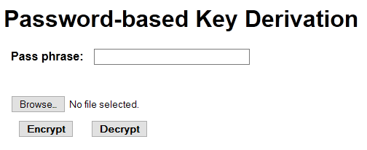
Lab 2 Application

Slide 73
Ways to Derive a Key From a Password
A password is just bytes, too, so use it as is
This is a terrible choice! Very susceptible to dictionary attack
Take the SHA-256 digest of the password
It’s the right length, but still subject to dictionary attack
Use a salted hash
Unless users share salt, a single fixed salt is only a little help
Use a key derivation algorithm

Slide 74
Ways to Derive a Key From a Password
A password is just bytes, too, so use it as is
This is a terrible choice! Very susceptible to dictionary attack
Take the SHA-256 digest of the password
It’s the right length, but still subject to dictionary attack
Use a salted hash
Unless users share salt, a single fixed salt is only a little help
Use a key derivation algorithm

Slide 75
Key Derivation Algorithms
Given a password, create a key
Avoid reversing or dictionary attacks
Typical method
Repeated salted hashing
Makes it too slow for effective dictionary attacks
SubtleCrypto deriveKey method options
CONCAT, HKDF-CTR, and PBKDF2 available in API

Slide 76
We Will Use PBKDF2
SubtleCrypto method needs a base key to start
This is a CryptoKey object representing the password
Use importKey to create this
Must provide a salt
Very helpful for password verification
Not as useful for encryption key because you don’t want to have different salts for different passwords
Iteration count should be high
1,000 was recommended in 2000. We will use 1,000,000.

Slide 77
Methods Used
importKey
To create the PBKDF2 “base key”
This base key is just a CryptoKey object representing the password/pass phrase
deriveKey
To create a 256-bit AES-CBC key from the base key
encrypt, decrypt
From file, to URL that can be saved as a file

Slide 78
New Background Needed
DOM FileReader object
Can read file selected in a form field
No Promise, just traditional callback
Provide success handler, get ArrayBuffer
DOM Blob object
Create from ArrayBuffer, or concatenate ArrayBuffers
Get URL, allowing download
See hints in lab2.js for more details

Slide 79
Steps
Derive key from password
Set up FileReader
Point success and error handlers to functions
Kick off FileReader (readAsArrayBuffer)
Success handler function:
Encrypt FileReader ArrayBuffer result
Create Blob from IV + ciphertext
Set window.location to Blob URL to download

Slide 80
Solution Review

Slide 81
Lab 3 – Digital Signing and Verification

Slide 82
What is a Digital Signature?
A piece of data derived from a key and a file that can show:
The signature was created using that file
With that key
Checking a signature is verification
Any change to file or use of wrong key will cause verification to fail

Slide 83
Basic Logical Mechanism
Sign
Take a digest (cryptographically strong hash) of file
Encrypt digest with the key. This is the signature.
Verify
Take a digest of the file
Decrypt the signature
Check that they match

Slide 84
Use Public Key Cryptography
Digital signatures usually use public key (asymmetric) cryptography
PKC uses key pairs, not one secret key
Public key and private key
Anything encrypted with one can only be decrypted with the other
Allows signature verification without being able to forge signature

Slide 85
Asymmetric Encryption
public key
encrypt
plaintext
ciphertext
decrypt
private key

Slide 86
Goals for Lab 3
Generate a PKC key pair suitable for digital signatures
Export both public and private keys, display as base 64 in form elements
Sign file with private key, display signature as base 64
Verify signed file with signature and public key

Slide 87
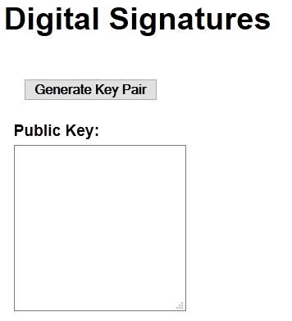
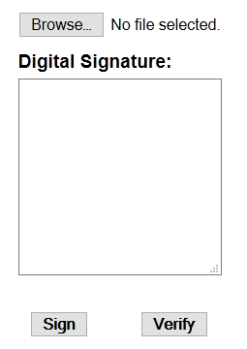
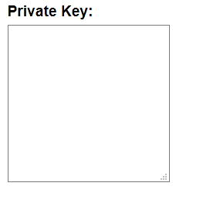
Lab 3 Application

Slide 88
Generating a Key Pair
generateKey with appropriate algorithm
RSASSA-PKCS1-v1_5 for signing
RSA-PSS is preferred but not yet widely available
RSA-OAEP for encrypting
There are other possible algorithms, but support is still spotty
Returned Promise yields CryptoKeyPair
Just an object with publicKey and privateKey properties

Slide 89
New Background Needed
Key formats for export and import
spki for public keys
pkcs8 for private keys
Could use jwk (JSON object) but single buffer returned by other formats easier
RSA algorithm properties
modulusLength – essentially key length in bits, use 2048
publicExponent – always use 65537 (0x10001)
hash – SHA-256
See hints in lab3.js

Slide 90
Signing Steps
Import private key
Set up FileReader
Point success and error handlers to functions
Kick off FileReader (readAsArrayBuffer)
Success handler function:
Sign FileReader ArrayBuffer result
Put base 64 encoded signature in form element

Slide 91
Verifying Steps
Import public key
Set up FileReader
Point success and error handlers to functions
Kick off FileReader (readAsArrayBuffer)
Success handler function:
Get signature from form element
Verify FileReader ArrayBuffer result

Slide 92
Solution Review

Slide 93
Lab 4 – Public Key Encryption and Decryption

Slide 94
PKC Has Limitations
Extremely slow
Message size limited by key size
So we can’t just encrypt plaintext using a PKC public key
This didn’t come up for signing, because there PKC is only used on a digest, not whole message

Slide 95
Need a Symmetric/Asymmetric Hybrid
Create a random symmetric key
This is called the session key
Encrypt the plaintext with the session key
Encrypt the session key with the public key using PKC
Decryption reverses this
Uses the private key to decrypt the session key

Slide 96
Goals for Lab 4
Generate a key pair, export, base 64 encode, and display in form
Encrypt file by importing public key, then create and encrypt session key (and store in form), then encrypt file with session key
Decrypt file by import private key, decrypting session key with the private key, importing session key and using it for decryption

Slide 97
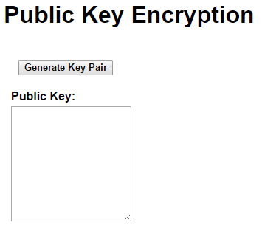
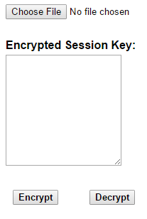
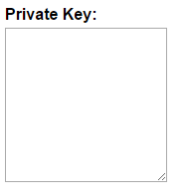
Lab 4 Application

Slide 98
New Background
Use RSA-OAEP public key algorithm
2048 bit modulus
65537 public exponent
SHA-256 hash
Use AES-CBC with 256-bit key for symmetric algorithm
See hints in lab4.js for more

Slide 99
Review Solution

Slide 100
Lab 5 – Self-signed X.509 Certificate

Slide 101
What’s a Certificate?
A data structure containing a public key and identification of the owner of that key
Digitally signed by a Certificate Authority (CA)
Reliers trust the CA, so they trust that the identity in the certificate is correct

Slide 102
X.509
Standard format for certificates
Comes from X.500 ITU-T and OSI standards
Created in the 1980s
ASN.1 “Abstract Syntax Notation”
Defines the data structure
BER and DER encoding into binary
Very compact, unambiguous, and horribly complex

Slide 103
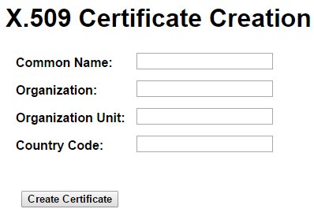
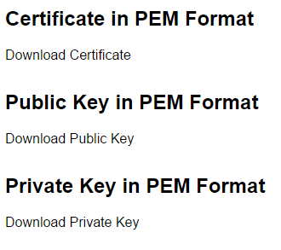
Lab 5 Application

Slide 104
This Lab is Different
No new cryptographic algorithms
New kinds of data objects
Certificate signing request
Certificate
No hands-on today
There are too many details in X.509 to cover them right now
Review the solution at a high level

Slide 105
We Won’t Do This from Scratch
Background needed for ASN.1 and encodings is enormous
See blog.engelke.com/tag/x-509 if you really want to try this (it feels so good when you stop)
Instead, we will use PKIjs library
Excellent third-party library (PKIjs.org)
Built on top of web crypto API

Slide 106
PKIjs Concepts
org.pkijs.simpl name space
CERT is the x.509 object constructor
Important properties
serialNumber – org.pkijs.asn1.INTEGER
extensions – array of org.pkijs.simpl.EXTENSION
Many, many, more

Slide 107
Solution Review

Slide 108
Summing Up

Slide 109
Web Cryptography API
Enables end-to-end secrecy and authentication
Uses well-established native libraries
Faster and more secure than re-implementing in JavaScript
API is fairly stable
Some algorithms that no (or only one) browser supports will be dropped
Interoperability is good

Slide 110
Learn More About Cryptography
Coursera Cryptography I course
Excellent introduction to fundamentals
Next offering starts March 14
https://www.coursera.org/learn/crypto
Coursera Cryptography II course
https://www.coursera.org/course/crypto2
Offered right after Lucy Van Pelt finally lets Charlie Brown kick the football

Slide 111
Resources
Web Cryptography API Candidate Recommendation
https://www.w3.org/TR/WebCryptoAPI/
Browser Crypto API test page
https://diafygi.github.io/webcrypto-examples/
From last year’s shorter talk
https://www.engelke.com/fluent/

